Slide 1
CS 7643-001 OAN OSZ Q Deep Learning
Final Project Dataset Proposal for RF Fingerprinting - Focused Problem
Greg Zdor
2-13-23

Slide 2
Dataset 1: Frequency Hopping Bluetooth dataset from IOT devices for RF Fingerprinting
Paper
https://ieee-dataport.org/documents/rf-fingerprint-bt-iot-real-world-frequency-hopping-bluetooth-dataset-iot-devices-rf
Key Features
10 classes
SDR = Ettus USRP X300 with UBX160 daughterboard, same antenna for all recordings
Recorded 2 MHz with Fc = 2.414 GHz
~ 75% of data recorded Day 1 (train/val set), ~ 25% recorded Day 2 (test set)
SigMF standard metadata format https://github.com/sigmf/SigMF
What’s unique
“Day1BT.tar.gz: Collected under line-of-sight conditions at varying distances per emitter as indicated in the associated JSON metadata file of each capture. The transmitter-receiver separation ranges from 1.6 ft to 9.8 ft in steps of 0.8 ft.
Day2BT.tar.gz: Collected under a challenging and rich multipath scattering scenario with maximum separation between the emitter and receiver being 24.2 ft. Each emitter is placed in the corners of the indoor laboratory as indicated by the lab layout picture with the receiver placed stationary at the center of the laboratory.” quoted from here
Size
2 recordings, compressed size = 10.47 GB
Each capture length = 40e6 IQ samples in np.complex64

Slide 3
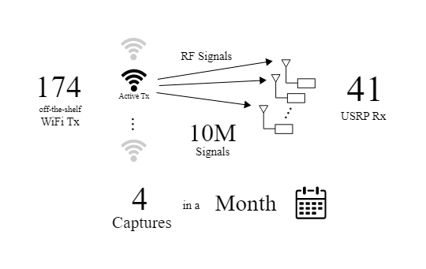
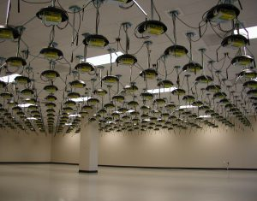
Dataset 2: WiSig
Paper
https://arxiv.org/pdf/2112.15363.pdf
https://cores.ee.ucla.edu/downloads/datasets/wisig/
From UCLA, captured using Orbit testbed grid
Key Features
41 USRP RXs
174 COTs WiFI TXs
Size
10 million packets collected in 4 captures spanning a month
79 GB processed, 1.4 TB Raw WiSig
About the signal(s) present
Raw IQ (noise → idle time) Raw WiSig (1.4 TB)
Processed: first 256 samples of unprocessed preambles (79 GB)
Comes with
Preprocessing scripts, examples, see https://github.com/WiSig-dataset/wisig-examples
To note
Contains captures from all TX and RX - not balanced though
Benefits
Multiple TX,RX present - enables showing RX generalization

Slide 4
Datasets covered by others & Misc.
Jordan
ADSB https://ieee-dataport.org/open-access/24-hour-signal-recording-dataset-labels-cybersecurity-and-iot
Bluetooth: https://zenodo.org/record/3876140
Sean
LoRa, Oregon State Univ. https://research.engr.oregonstate.edu/hamdaoui/sites/research.engr.oregonstate.edu.hamdaoui/files/release_note_2021.pdf
WiFi preambles IEEE https://cores.ee.ucla.edu/downloads/datasets/rf-fingerprinting-dataset/ ​
Other relevant papers
https://ece.northeastern.edu/fac-ece/ioannidis/static/pdf/2020/J_Jian_RFDeepLearning_IoT_2020.pdf - developed under DARPA’s RFMLS contract
Github of NNs https://github.com/neu-spiral/RFMLS-NEU
GSM cell signals dataset (452 MB): https://ieee-dataport.org/documents/gsm-radio-frequency-fingerprinting
Channel robust RF fingerprinting: https://www.exptechinc.com/charrnets-channel-robust-representation-networks-for-rf-fingerprinting/ another DoD company doing RF Fingerprinting for DARPA
Questions
Do we have a dataset with multiple antennas? Would be neat to show the NN generalizes across antenna. Same for SDR

Slide 5
My other updates
Created Word Doc for proposal
https://gtvault.sharepoint.com/:w:/s/Spring2023DeepLearningProject/EaPU8twMQ4dCkyciaVNgzr4BjzwmHF_1RJbbyCdCvR3XYQ?e=nGRWTm
Confirmed access to github - https://github.gatech.edu/jbarker63/CS-7643-Deep-Learning-Group-Project - thx Jordan

Slide 6
Other Discussion Items
Create task list for next week
Figure out who’s going to do what for the proposal
Let’s get started on data loader
Start discussing different data formats our NNs may need (constellation image, raw I and Q as separate vectors), spectrogram image)

